Slide 1


Node js LectuRe 2
National Telecommunication Institute
Ministry of Communications and Information Technology

Slide 2
Agenda
custom modules
NPM(node modules , package.json)
HTTP Request & Response
Express
What is Restful api
How to serve static files
Node js debugging

Slide 3
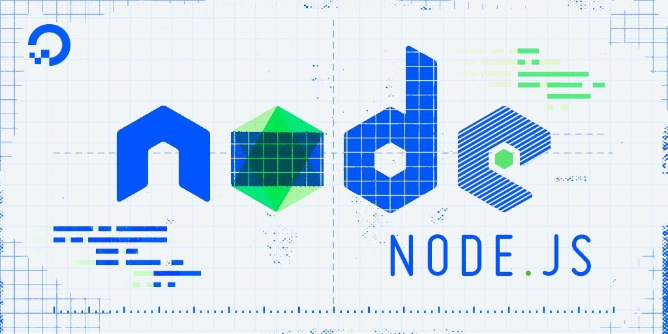
Custom Modules
How it works
5 Global Variables(require , module , dirname ,
filename , exports)
Native Modules
Caching

Slide 4
NPM
Every Node application has a package.json file that includes metadata about the application. This includes the name of the application, its version, dependencies,etc.
We use NPM to download and install 3rd-party packages from NPM registry.
- All the installed packages and their dependencies are stored under node_modules folders.
// Install a package
npm i <packageName>
// Install a specific version of a package
npm i <packageName>@<version>
// Install a package as a development dependency
npm i <packageName> —save-dev
// Uninstall a package
npm uninstall <packageName>
Npm install

Slide 5
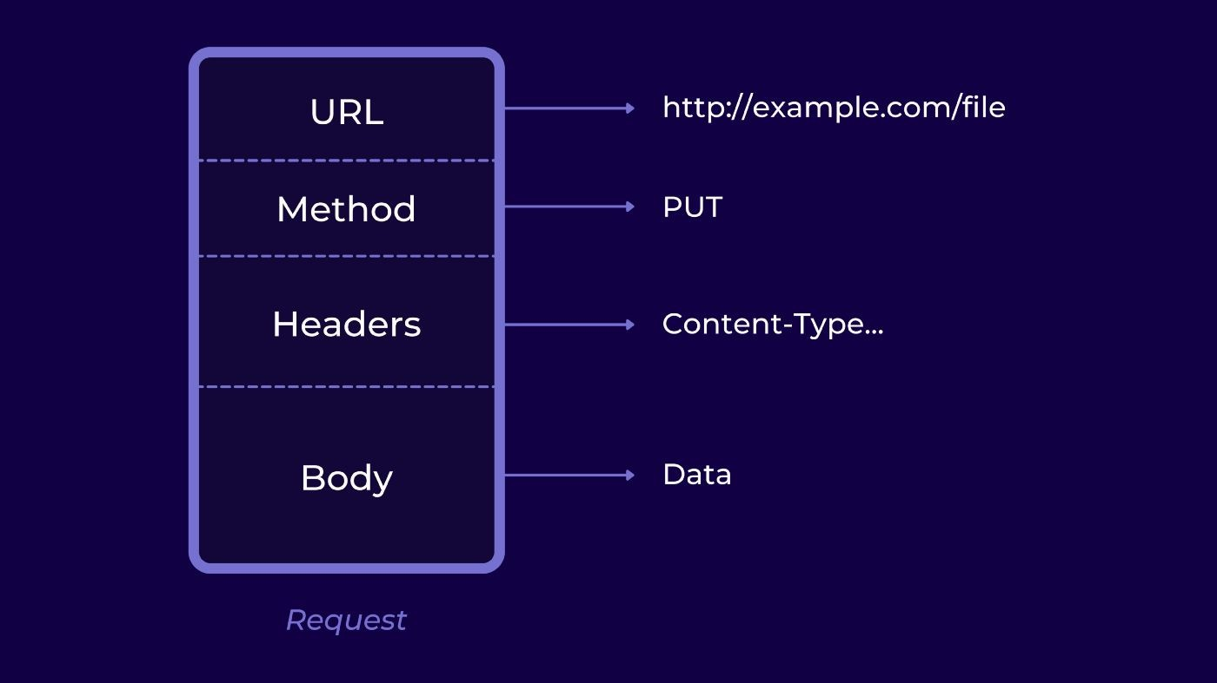
HTTP REQUEST

Slide 6
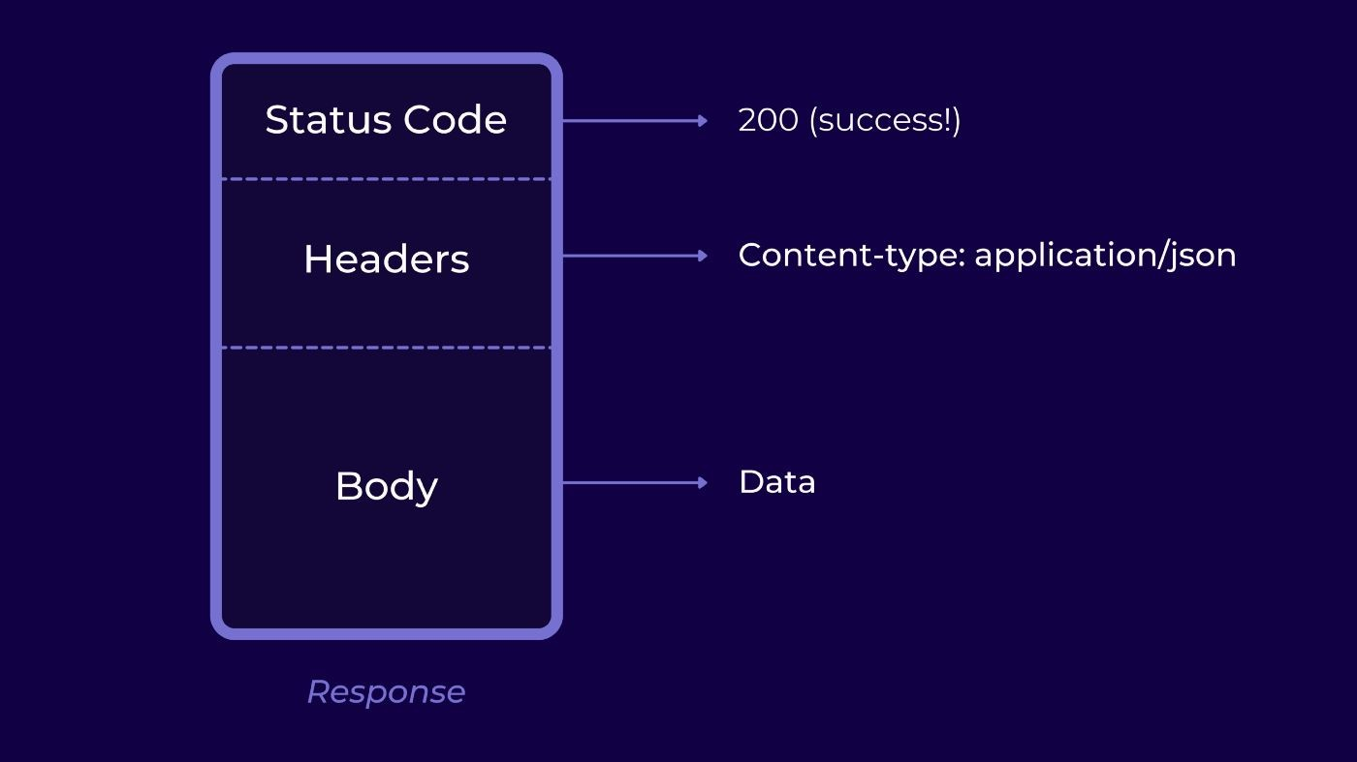
HTTP RESPONSE

Slide 7
ExpRess Js
Express is a minimal and flexible Node.js web application framework that provides a robust set of features to develop web and mobile applications. It facilitates the rapid development of Node based Web applications. Following are some of the core features of Express framework −
Allows to set up middlewares to respond to HTTP Requests.
Defines a routing table which is used to perform different actions based on HTTP Method and URL.
Allows to dynamically render HTML Pages based on passing arguments to templates
// Install a package npm i express

Slide 8
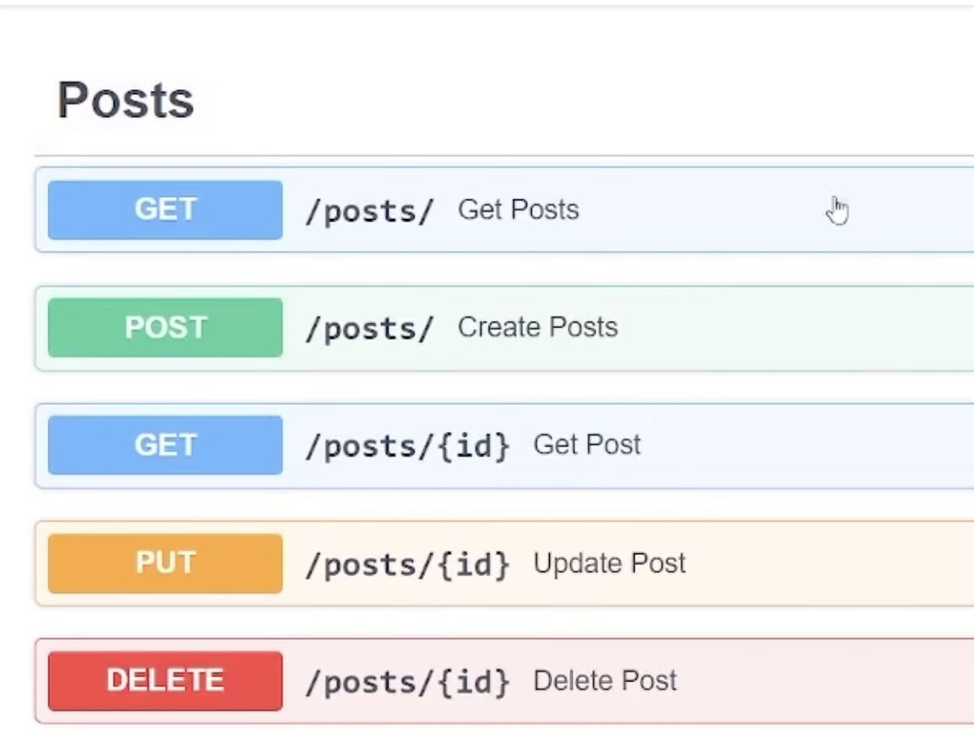
Restful API

Slide 9
Thank you

